Slide 1
Predicting the growth and trend of COVID-19 (Indian States) using Machine Learning
HSO-201
Research Paper
Course Instructor - Prof. S. K. Mathur

Slide 2
Abstract:
Covid-19 has turned out as a global pandemic infecting millions of people worldwide. In a densely populated country like India the cumulative cases are rapidly increasing with time.
Many prior studies have been accomplished to track the disease, growth prediction and possible management policies but they are not so effective considering the vast diversity of a country like India.
In this study, we have shifted our focus on the number of infections in individual Indian states and try to create a model which can predict the number of infections for that state in the next 60-90 days.
Link to Synopsis: https://docs.google.com/document/d/1vrXlU_ZhAJ1HyoHki4dIenqLM03jWgLjnEbrO6DRwzo/edit?usp=sharing

Slide 3
Introduction:
On December 31, 2019, China reported WHO about unusual pneumonia cases being witnessed in the city of Wuhan. It was the very beginning of COVID-19.
The first case was reported in India at the end of January 2020. Around 11 million cases have been reported in India till now, with 157K deaths.
After following an exponential growth, fortunately, cases in India are decreasing now, But if we see at state-level, distribution of covid outbreak is dynamic. It is still a havoc for states like Maharashtra but in north-east the situation seems to be under control.
Our group makes a small endeavor in similar regard. We are trying to analyze and predict the pandemic situation in different states of India. We are using Machine learning algorithms like Levenberg-Marquardt (LM) for curve fitting. We will be trying and testing various distributions and try to present the best fit in different scenarios.

Slide 4
Literature Review:
Machine Learning (ML) and Data Science community are striving hard to improve the forecasts of epidemiological models and analyze the information flowing over Twitter for the development of management strategies, and the assessment of impact of policies to curb its spread. Various datasets in this regard have been openly released to the public. Yet, there is a need to capture, develop and analyse more data as the COVID-19 grows worldwide. (Shreshth Tuli, 2020).
There are a few works done that are based explicitly on Indian COVID-19 data. Das S. has used the epidemiological model to estimate the basic reproduction number at national and some state levels. Ray D, Salvatore M, Bhattacharya R, et al. used a predictive model for case-counts in India. They also discussed hypothetical interventions with various intensities and provided projections over a time horizon. Both the articles have used SIR (susceptible-infected-removed) model for their analysis and prediction.

Slide 5
Dataset Review and Exploratory Data Analysis:
The dataset that we will be using is available on the Internet and available for public use. The main dataset on which the research has been carried is from "Our World in Data" by Hannah Ritchiee.
This dataset contains a lot of unique parameters like reproduction rate, information about hospital admissions, handwashing facilities, diabetes prevalence, GDP per capita, which makes its prediction more robust.
Note: The datasets, which contain information about different Indian states, do not have as much information as we have for India. Therefore, one should not expect much robust prediction on the state's data.

Slide 6
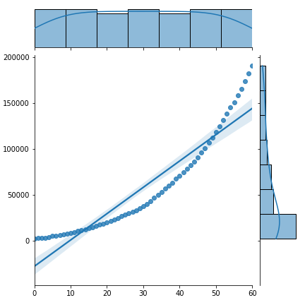
Dataset Review and Exploratory Data Analysis (Contd..):
The curve illustrates the regression plot and histogram plot on the sides between the total cases from April 2020 to May 2020 in India .
As we can see from the figure, the total cases are rising exponentially, which is indicative that the trend is non-linear from the very beginning.

Slide 7
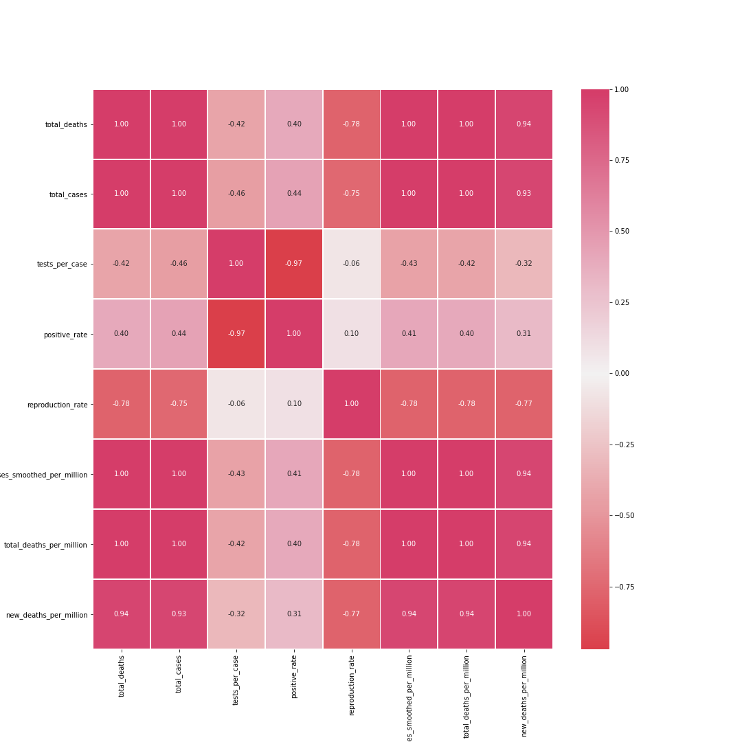
Dataset Review and Exploratory Data Analysis (Contd..):
The correlation matrix is shown as heatmap between various features of the dataset.
Each cell in a table shows the correlation between the two variables.
A Correlation value of +1 means strong positive correlation, whereas a value of -1, means a strong negative correlation.

Slide 8
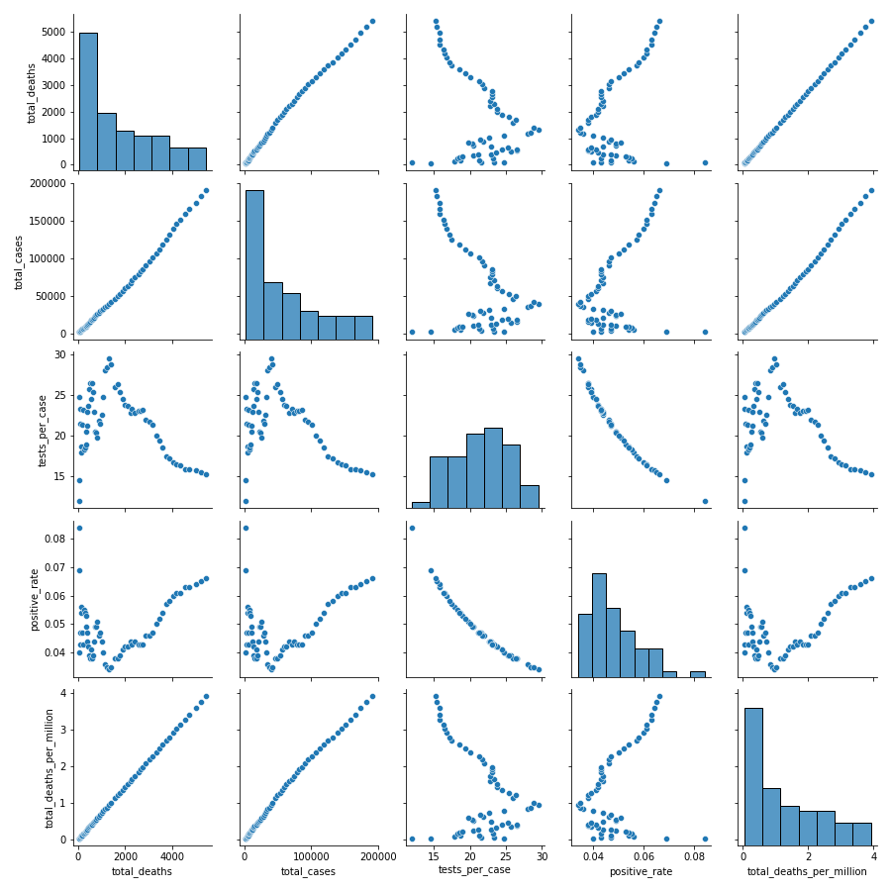
Dataset Review and Exploratory Data Analysis (Contd..):
A pairplot between various features are shown.
The pairplot function is used to plot multiple pairwise bivariate distribution in a data set.
It explains the relationship between various variables present in the dataset.
The Colab-notebook is linked here

Slide 9
Objectives and Hypotheses:
Main Objective: To explore the trend of COVID-19 in Indian States.
Our Research will help us finding the answer to following questions-
Which states are under adverse conditions and which are under good control?
What is the expected number of cases after the end of November?
When will COVID-19 vanish in India?
What is Mortality Rate (State-Wise)?

Slide 10
Methodologies and Methods:
As guided by the Base-Paper, We will use mathematical modeling to predict the trend of patient diagnosis in Indian states, with the aim of easing anxiety regarding the emergent situation.
According to all diagnosis numbers from the WHO website and combining with the transmission mode of infectious diseases, the mathematical model was fitted to predict the future trends of outbreaks.
This can be done using the popular Machine Learning technique of Levenberg-Marquardt (LM) for curve fitting as various researches have suggested that during the initial stages of COVID, the data had many outliers and noise.

Slide 11
Methodologies and Methods(Contd..):
The Levenberg-Marquardt algorithm adaptively updates the parameter between the gradient descent (in left image) update and the Gauss-Newton (in right image) update.

Slide 12
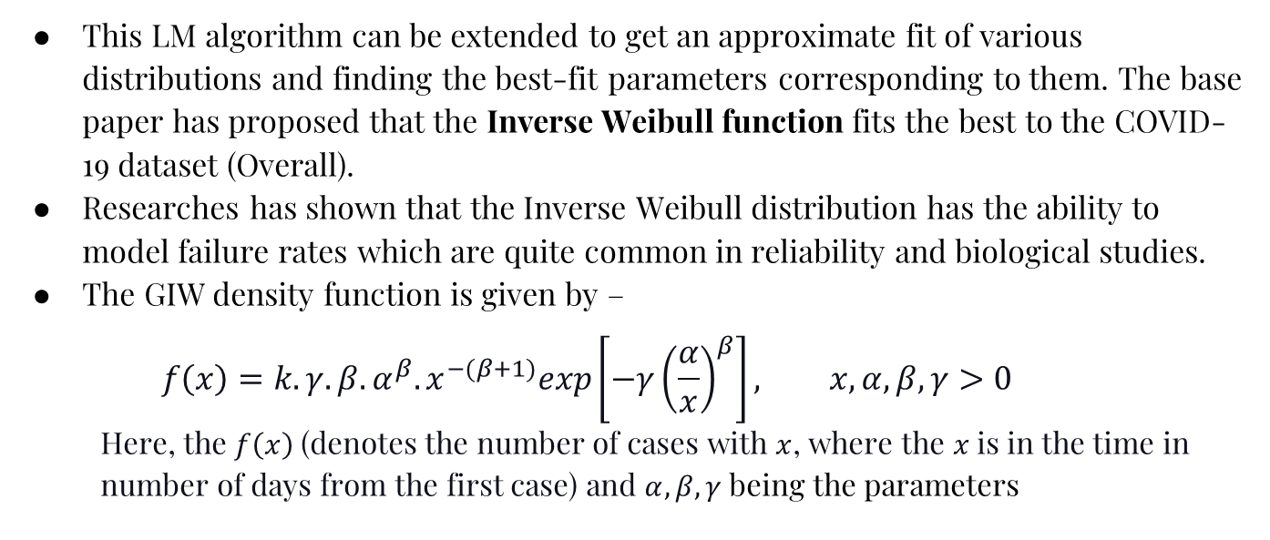
Methodologies and Methods(Contd..):
This LM algorithm can be extended to get an approximate fit of various distributions and finding the best-fit parameters corresponding to them. The base paper has proposed that the Inverse Weibull function fits the best to the COVID-19 dataset (Overall).
Researches has shown that the Inverse Weibull distribution has the ability to model failure rates which are quite common in reliability and biological studies.
The GIW density function is given by –
$$f\left(x\right)=k.γ.β.α^{β}.x^{−(β+1)}exp\left[−γ{\left(\frac{α}{x}\right)}^{β}\right], x, α, β, γ>0$$
Here, the $f\left(x\right)$(denotes the number of cases with $x$, where the $x$is in the time in number of days from the first case) and $α, β, γ$ being the parameters

Slide 13
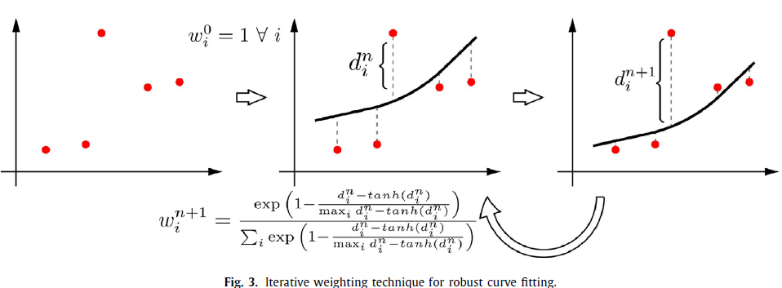
Methodologies and Methods(Contd..):
As proposed by the Base-Paper, Iterative Weibull showed an average MAPE of 12% lower than non-iteratively weighted Weibull. A step-by-step algorithm has been proposed for iteratively weighted curve fitting using the GIW distribution (called ”Robust Weibull”)

Slide 14

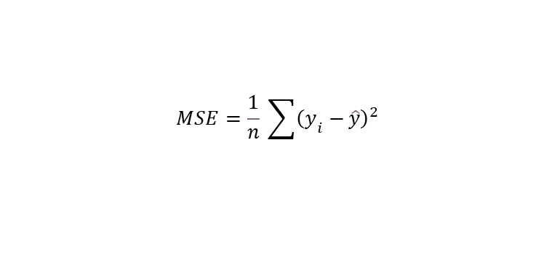
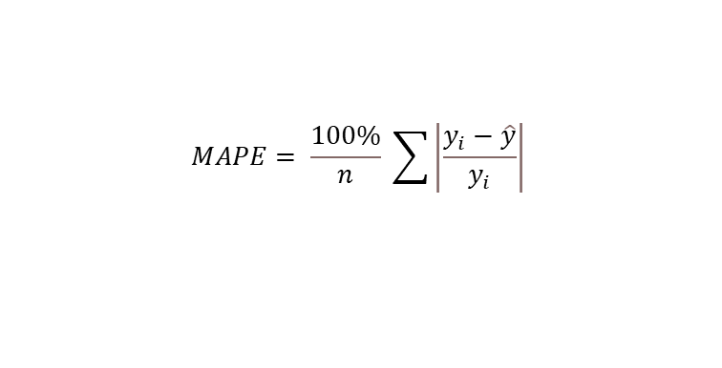
Methodologies and Methods(Contd..):
We will try fitting iterative versions of Gaussian, Beta (4-parameter), Fisher Tippett, and Lognormal functions and find the best one out by measuring different comparison metrics.
The loss functions which we will be using in order to find the best fit will be MSE(Mean Squared Error), R² or the Coefficient of determination, and MAPE (Mean Absolute Percentage Error).
The least MSE/MAPE and highest R² values among different models can be compared and hence the best fit model can be found.
$$R^{2}=1− \frac{\sum{{\left(y\right.}_{i}−\hat{y}})}{\sum{{\left(y\right.}_{i}−}{\left.\overline{y}\right)}^{2}}$$
$$MSE=\frac{1}{n} \sum{{\left(y\right.}_{i}−}{\left.\hat{y}\right)}^{2}$$
$$MAPE= \frac{100\%}{n} \sum{\left|\frac{y_{i}−\hat{y}}{y_{i}}\right| }$$

Slide 15
References:
[Base Paper] - Predicting the growth and trend of COVID-19 pandemic using Machine learning and Cloud Computing.
Background Paper on COVID-19 WHO.
Prediction of COVID-19 Disease progression in India - under the effect of National Lockdown.
Predictions, role of interventions and effects of a historic national lockdown in India’s response to the COVID-19 pandemic: data science call to arms.
Ghosh, Palash & Ghosh, Rik & Chakra borty, Bibhas. (2020). COVID-19 in India: State-wise Analysis and Prediction.
The Levenberg-Marquardt Algorithm - Theory and Implementation.
The Generalized Inverse Weibull Distribution

Slide 16
Thank You!
A Presentation by-
Name - Roll No | Name - Roll No
Akashdeep Bhateja - 190085 (Leader) | Ajit Meena - 190076
Prakarsh Agrawal - 190615 | Pratyush Baiplawat - 190640
Chandra Shekhar - 190246 | Akash Kar - 190080
Kuldeep Meena - 190442 | Poluri Bhakthi Reddy - 190604
Harsh Mishra - 190362 | Dhananjay Gupta - 190280
Vijay Fagaria - 190961

